Slide 1
Computer Networks
CSE405
Data Link Layer
Rabea Khatun
Lecturer
Dept. Of CSE
East West University

Slide 2
Carrier Sense Multiple Access with Collision Detection (CSMA/CD)
The CSMA method does not specify the procedure following a collision. Carrier senses multiple access with collision detection (CSMA/CD) augments the algorithm to handle the collision.
In this method, a station monitors the medium after it sends a frame to see if the transmission was successful. If so, the transmission is finished. If, however, there is a collision, it stops transmission immediately and instead transmits a jam sequence.

Slide 3
Cont.
If a collision is heard, both of the senders will send a jam signal over the channel. This jam signal indicates to all other devices that there has been a collision, and they should not send data onto the wire.
After sending the jam signal, each of the senders will wait a random amount of time before beginning the entire process over. The random time helps to ensure that the two devices don't transmit simultaneously again.

Slide 4
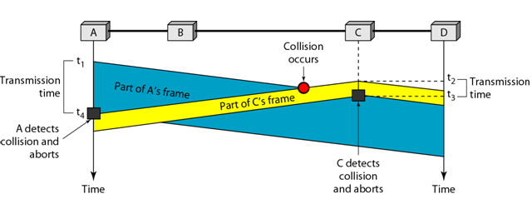
Cont.
To better understand CSMA/CD, let us look at the first bits transmitted by the two stations involved in the collision. Although each station continues to send bits in the frame until it detects the collision, we show what happens as the first bits collide. In Figure below, stations A and C are involved in the collision.

Slide 5
Cont.
At time t1, station A has executed its persistence procedure and starts sending the bits of its frame.
At time t2, station C has not yet sensed the first bit sent by A.
Station C executes its persistence procedure and starts sending the bits in its frame, which propagate both to the left and to the right.

Slide 6
Cont.
The collision occurs sometime after time t2. Station C detects a collision at time t3 when it receives the first bit of A's frame.
Station C immediately aborts transmission. Station A detects collision at time t4 when it receives the first bit of C's frame; it also immediately aborts transmission.
Looking at the figure, we see that A transmits for the duration t4 - tl; C transmits for the duration t3 –t2. At time t4, the transmission of A’s frame, though incomplete, is aborted; at time t3, the transmission of C's frame, though incomplete, is aborted.

Slide 7
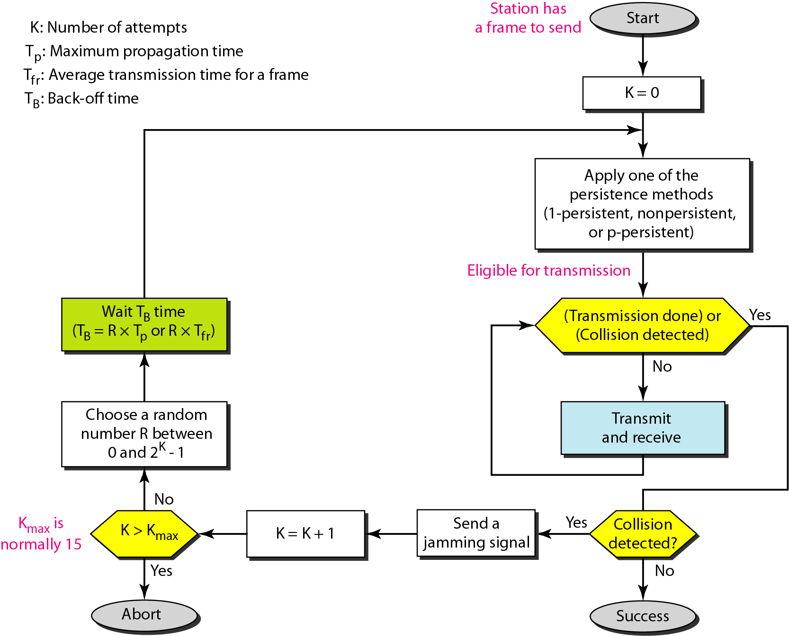
CSMA/CD flow diagram

Slide 8
How Does CSMA/CD Work?
Step 1: Check if the sender is ready to transmit data packets.
Step 2: Check if the transmission link is idle.
Step 3: Transmit the data & check for collisions. The sender transmits its data on the link. CSMA/CD does not use an ‘acknowledgment’ system. It checks for successful and unsuccessful transmissions through collision signals. During transmission, if a collision signal is received by the node, transmission is stopped. The station then transmits a jam signal onto the link and waits for random time intervals before it resends the frame. After some random time, it again attempts to transfer the data and repeats the above process.
Step 4: If no collision was detected in propagation, the sender completes its frame transmission.

Slide 9
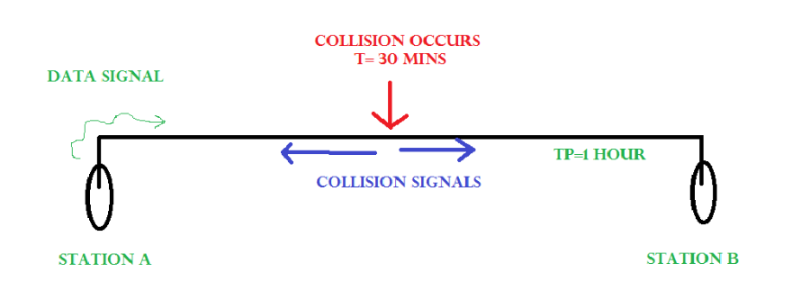
How Does a Station Know if Its Data Collide?
Consider the above situation. Two stations, A & B. Propagation Time: Tp = 1 hr ( Signal takes 1 hr to go from A to B)
At time t=0, A transmits its data. t= 30 mins : Collision occurs.
After the collision occurs, a collision signal is generated and sent to both A & B to
inform the stations about the collision. Since the collision happened midway, the collision signal also takes 30 minutes to reach A & B.
Therefore, t=1 hr: A & B receive collision signals.
This collision signal is received by all the stations on that link.

Slide 10
Cont.
How to Ensure that it is our Station’s Data that Collided?
For this, Transmission time (Tt) > Propagation Time (Tp) This is because we want that before we transmit the last bit of our data from our station, we should at least be sure that some of the bits have already reached their destination. This ensures that the link is not busy and collisions will not occur.
Consider the above system again.

Slide 11
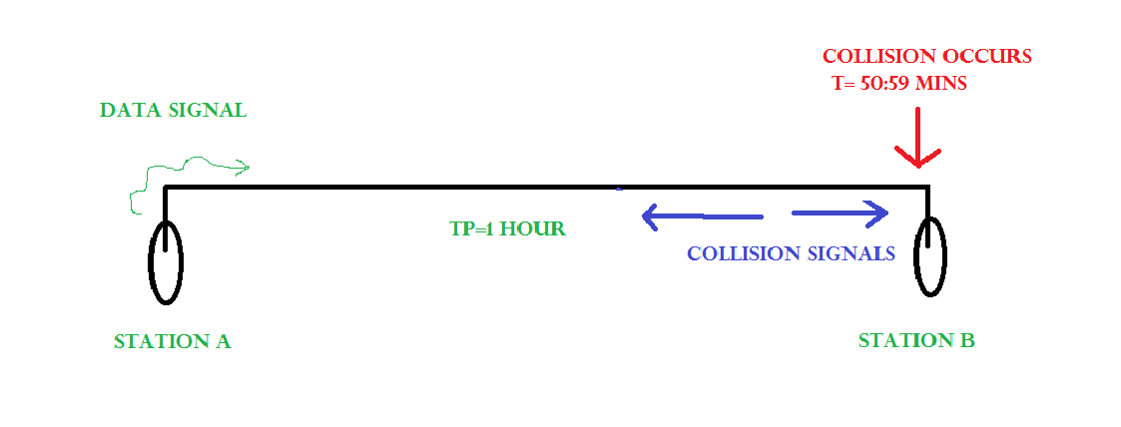
Cont.
At time t=0, A transmits its data. t= 59:59 mins : Collision occurs
This collision occurs just before the data reaches B. Now the collision signal takes 59:59 minutes again to reach A.
Hence, A receives the collision information approximately after 2 hours, that is, after 2 * Tp.
Hence, to ensure tighter bound, to detect the collision completely, Tt > >= 2 * Tp
This is the maximum collision time that a system can take to detect if the collision was of its own data.

Slide 12
Cont.
What should be the Minimum length of the Packet to be Transmitted?
Transmission Time (Tt) = Length of the packet/ Bandwidth of the link [Number of bits transmitted by sender per second]
Substituting above, we get, Length of the packet/ Bandwidth of the link>= 2 * Tp
= Length of the packet >= 2 * Tp * Bandwidth of the link
Padding helps in cases where we do not have such long packets.
We can pad extra characters to the end of our data to satisfy the above condition.

Slide 13
Problem
A network using CSMA/CD has a bandwidth of 10 Mbps. If the maximum propagation time is 25.6 μsec, what is the minimum size of the frame?
Solution
The frame transmission time is T_{fr} = 2 x Tp =51.2 μs. This means, in the worst case, a station needs to transmit for a period of 51.2 μs to detect the collision. The minimum size of the frame is 10 Mbps x 51.2 μsec =512 bits or 64 bytes.

Slide 14
Controlled Access
A station must be authorized by someone (e.g., other stations) before transmitting
Three common methods:
Reservation
Polling
Token passing

Slide 15
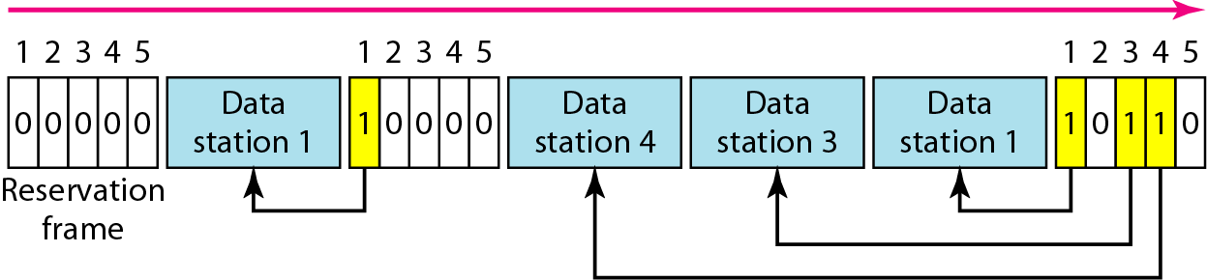
Reservation
Stations take turns transmitting a single frame at a full rate ( R ) bps
Transmissions are organized into variable length cycles
Each cycle begins with a reservation interval that consists of (N) mini slots. One mini slot for each of the N stations
When a station needs to send a data frame, it makes a reservation in its own mini slot.

Slide 16
Reservation-Cont.
By listening to the reservation interval, every station knows which stations will transfer frames, and in which order.
The stations that made reservations can send their data frames after the reservation frame.

Slide 17
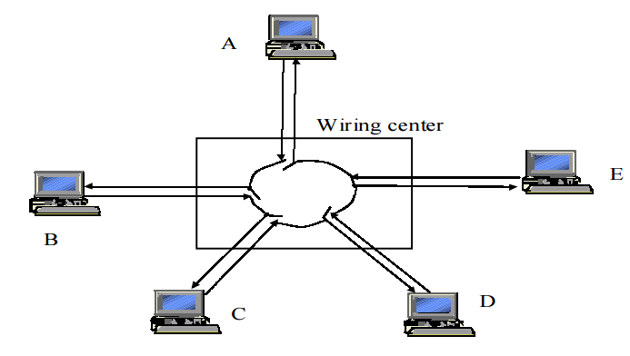
Token Passing
Token ring local area network (LAN) technology is a communications protocol for local area networks.
It uses a special three-byte frame called a "token" that travels around a logical "ring" of workstations or servers.
This token passing is a channel access method providing fair access for all stations, and eliminating the collisions of contention-based access methods.

Slide 18
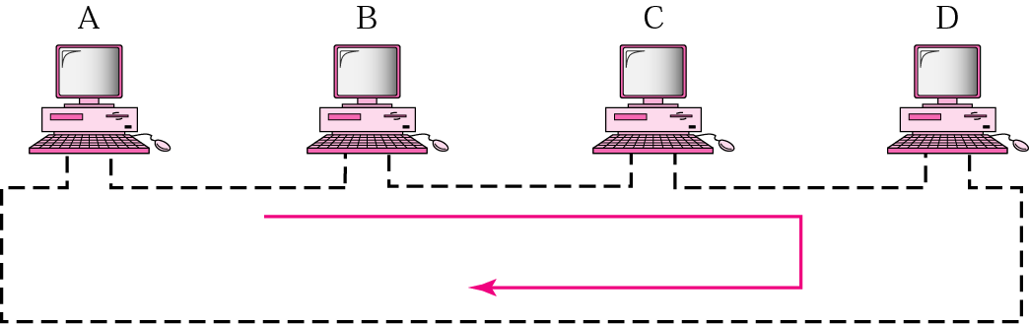
Token Passing
In the token-passing method, a station is authorized to send data when it receives a special frame called a token.
In this method, stations are arranged around a ring.
Each station has a predecessor and a successor.
Frames are coming from the predecessor and going to the successor.

Slide 19
Cont.
Token ring :a number of stations connected by transmission links in a ring topology. Information flows in one direction along the ring from source to destination and back to source.
Medium access control is provided by a small frame, the token, that circulates around the ring when all stations are idle. Only the station possessing the token is allowed to transmit at any given time.

Slide 20
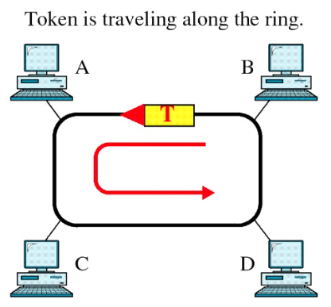
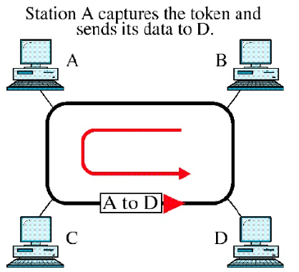
Access Method: Token Passing

Slide 21
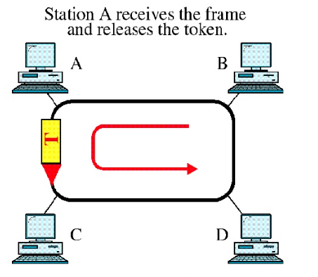
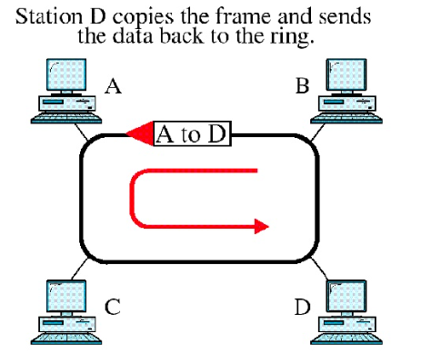
Cont.

Slide 22
Access Method Cont.
Whenever the network is unoccupied, it circulates a simple three byte token.
The token is passed from NIC (Network Interface Card) to NIC in sequence until it encounters a station with data to send.
That station waits for the token to enter its network board.
It keeps the token and sets a bit inside its NIC as a remainder that is has done so, then sends its one data frame.

Slide 23
Access Method Cont.
This data frame proceeds around the ring.
Each intermediate station examines the destination address, finds that the frame is addresses to another station, and relays it to its neighbors.
The intended recipient recognizes its own address, copies the message, check the errors, and changes four bits in the last byte of the frame to indicate address recognized and data received successfully and frame copied.
The full packet then continues around the ring until it returns to the sender that sent it.

Slide 24
Access Method Cont.
The sender receives the frame and recognizes itself in the source address field.
It then examines the address-recognized bits. If they are set, it knows that the frame was received.
The sender then discards the used data frame and release the token back to the ring.

Slide 25
Priority and Reservation
Generally, once a token has been released, the next station on the ring with data to send has the right to take charge of the ring.
However another option is possible.
The busy token can be reserved by a station waiting to transmit regardless of the station’s location on the ring.
Each station has a priority code.
As a frame passes by, a station waiting to transmit may reserve the next open token by entering its priority code in the access control (AC) field of the token or data frame.

Slide 26
Priority and Reservation
A station with a higher priority may remove a lower priority reservation and replace it with its own.
Among stations of equal priority, the process is first-come, first served.
Through this mechanism, the station holding the reservation gets the opportunity to transmit as soon as the token is free, whether or not it comes next physically on the ring.

Slide 27
Polling
Polling works with topologies in which one device is designed as a primary station and the other devices are secondary stations.
All data exchange must be made through the primary device even when the ultimate destination is a secondary device.
The primary device control the links; the secondary devices follow its instructions.
It is up to the primary device to determine which device is allowed to use the channel at a given time.

Slide 28
Polling-Cont.
The primary device, therefore is always the initiator of a session.
If the primary station wants to receive data, it asks the secondaries if they have anything to send; this function is called polling.
If the primary device wants to send data, it tells the secondary target to get ready to receive; this function is called selecting.

Slide 29
Select
The select mode is used whenever the primary device has something to send.
What it does not know, however, is whether the target device is prepared to receive.

Slide 30
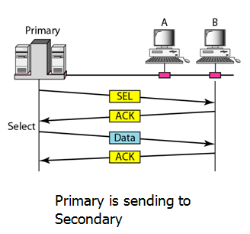
Select-Cont.
So the primary must alert the secondary to the upcoming transmission and wait for an acknowledgement of the secondary’s ready station.
Before sending data, the primary creates and transmits a select (SEL) frame, one field of which includes the address of the intended secondary.

Slide 31
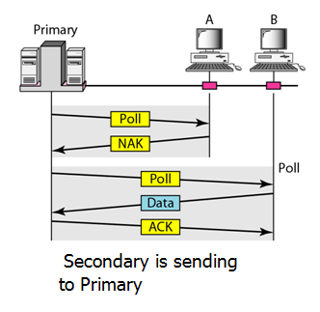
Poll
The polling function is used by the primary device to solicit transmissions from the secondary devices.

Slide 32
Poll-Continue
When the primary is ready to receive data, it must ask (poll) each device in turn if it has anything to send.
When the first secondary is approached, it responds either with a NAK frame it has nothing to send or with data (in the form of a data frame) if it does.
If the response in negative (a NAK frame), the primary then polls the next secondary in the same manner until it finds one with data to send.
When the response is positive (a data frame), the primary reads the frame and returns an acknowledgement (ACK), verifying its receipt.

